Slide 1


SocialBuzz
Content
Analysis

Slide 2


Today's agenda
Project recap
Problem
The Analytics team
Process
Insights
Summary

Slide 3

SocialBuzz is a fast growing Social media & content creation industry that needs to adapt quickly to the fast growing global scale. Accenture is running a 3 month initial project in order to prove to them that we are the best firm to work with. They are expecting the following:
An audit of their big data practice
Recommendations for a successful IPO
An analysis of their content categories that highlights the top 5 categories with the largest aggregate popularity
Project Recap

Slide 4

Problem
The client has reached a massive scale within recent years
Over 100000 posts per day 36,500,000 pieces of content per year!

Slide 5



CHIEF TECHNOLOGY ARCHITECT
ANDREW FLEMMING
The Analytics team
SENIOR PRINCIPAL
MARCUS ROMPTON
DATA ANALYST
KEERTHANA MALLAVARAPU

Slide 6
IDENTIFY THE PROBLEM
Process
1
GATHER DATA
2
3
CLEAN THE DATA
4
VISUALISE THE DATA
5
DERIVE INSIGHTS

Slide 7

Insights
16
UNIQUE CATEGORIES
JANUARY
MOST NUMBER OF POSTS
More POSITIVE REACTIONS than NEGATIVE

Slide 8
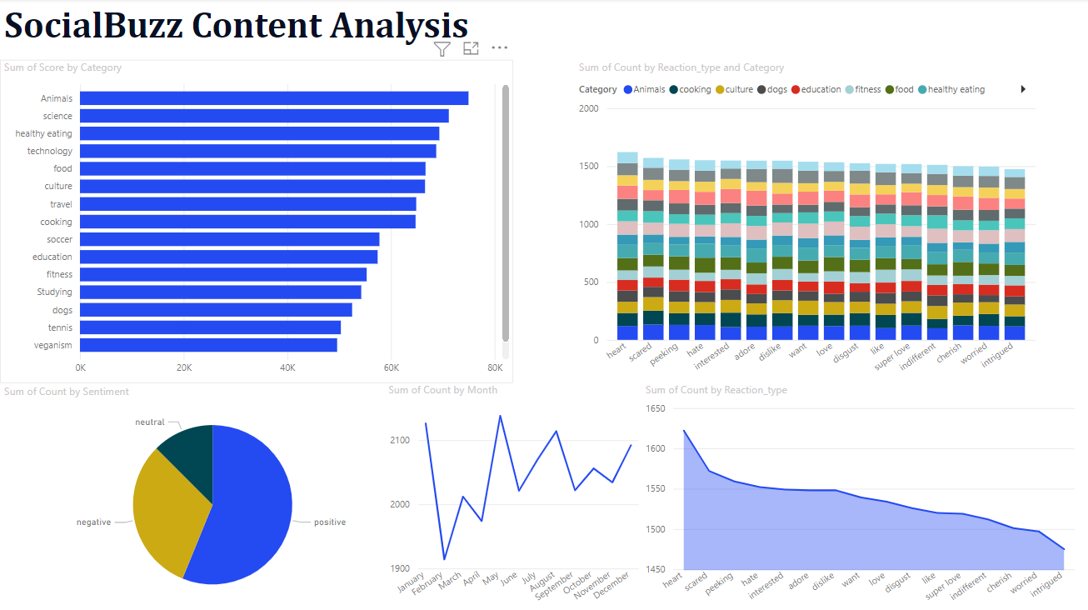

Slide 9
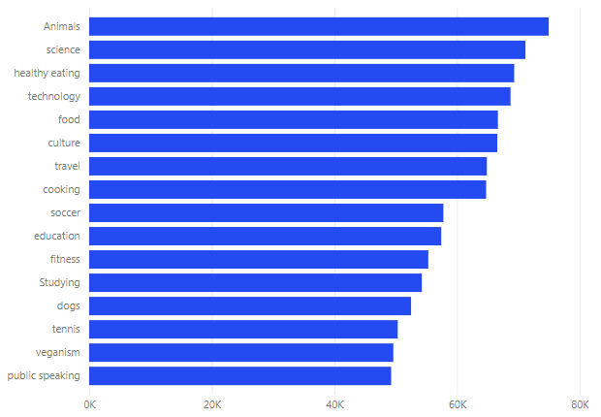
CATEGORIES FROM MOST POPULAR TO LEAST POPULAR

Slide 10

ANALYSIS:
People react positively to posts than negatively which shows that the content posted on the platform is positive.
INSIGHTS:
‘Science’ and ‘Technology are among the top 5 popular categories showing that the users of the platform are mostly from tech background. This insight can be used to focus more on this audience by creating a new space or a separate app.
Summary

Slide 11
Thank you!
ANY QUESTIONS?

